Slide 1

List Comprehension and Python Packages

Slide 2
List Comprehension
List comprehension is useful for efficient and concise list creation
Faster than a for loop due to C implementation.
Sometimes they are less readable than for loops.
Very useful for reading files.
There is also dictionary comprehension.
We will begin with somewhat arbitrary uses and then move to more application that can make certain tasks way easier!

Slide 3
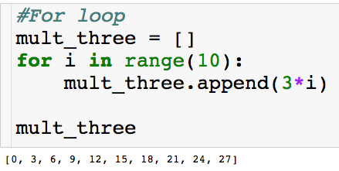
List Comprehension
Basic use - let’s create a list of the first 10 multiples of 3:
Before:

Slide 4
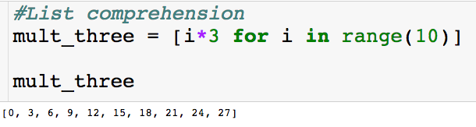
List Comprehension
Basic use - let’s create a list of the first 10 multiples of 3:
Before:
Now:

Slide 5

Closer Look
Let’s take a closer look at the list comprehension
“Place i*3 in the list for each i from 0 to 9”

Slide 6
Closer Look
Let’s take a closer look at the list comprehension

Slide 7
Closer Look
Let’s take a closer look at the list comprehension

Slide 8
Closer Look
Let’s take a closer look at the list comprehension

Slide 9
Closer Look
Let’s take a closer look at the list comprehension
And so on…

Slide 10
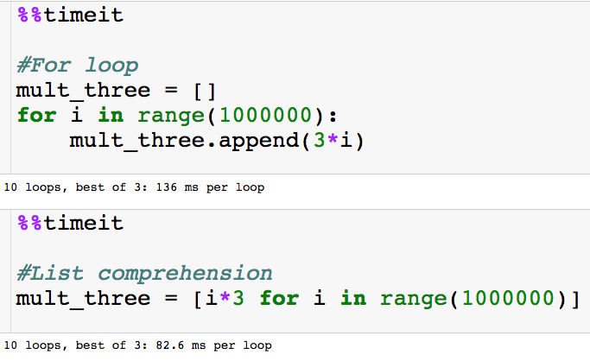
Speed-Up
Let’s look at the time to generate the first one million multiple of 3:
Jupyter magic

Slide 11
Speed-Up
Let’s look at the time to generate the first one million multiple of 3:
List comprehension is almost twice as fast just for this simple task!
Jupyter magic

Slide 12
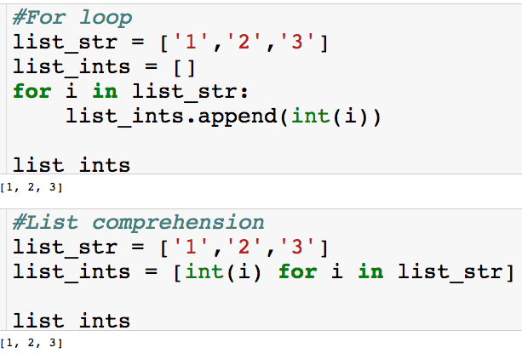
Another Simple Example
The task of converting a list of strings to a list of ints:
Before:
Now:

Slide 13
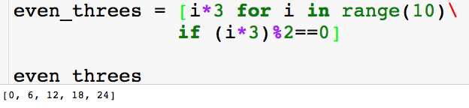
Adding an if Statement
We can throw in an if statement in the list comprehension. Let’s say we only want even multiples of 3:

Slide 14
Adding an if Statement
We can throw in an if statement in the list comprehension. Let’s say we only want even multiples of 3:

Slide 15
Adding an if Statement
We can throw in an if statement in the list comprehension. Let’s say we only want even multiples of 3:

Slide 16
Adding an if Statement
We can throw in an if statement in the list comprehension. Let’s say we only want even multiples of 3:
And so on…

Slide 17
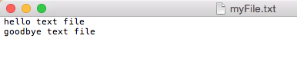
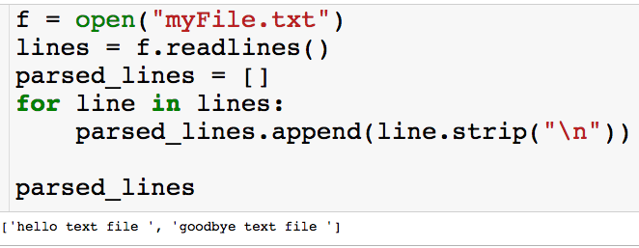
List Comprehension with Files
Without list comprehension, here is how we got a list of the lines:

Slide 18
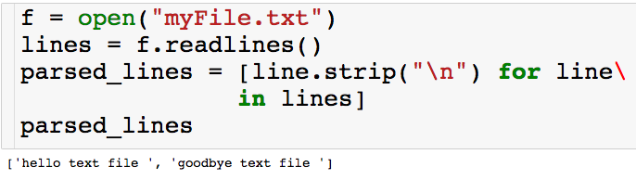
List Comprehension with Files
With list comprehension:

Slide 19
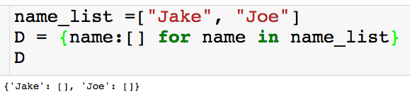
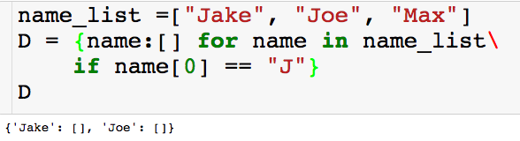
Dictionary Comprehension
We also employ these ideas using dictionaries:

Slide 20
Python Packages
Python has many built in packages that makes things a lot easier.
Here are the main ones we will consider
os: operator system interface
numpy: matrix algebra, random number generation
scipy: random number generation, optimization
pandas: reading csv/xls files, data analytics, plotting

Slide 21
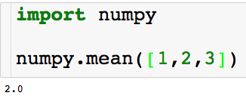
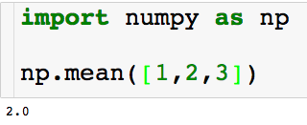
Importing Python Packages
There are two main ways to import packages:
Using the mean module in the numpy package

Slide 22
OS Package
The os package helps us interact with the operation system.
With the os package we can:
View/change working directory
View contents of folder
Create new folder
Walk over the contents of entire folder

Slide 23

My Desktop

Slide 24

File Directories
Desktop
Data_1
Data_2
How do I set my working directory to the Desktop?

Slide 25
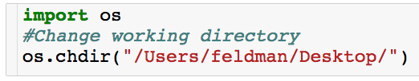
File Directories
Desktop
Input is file path as string
Directories separated by forward slash
Data_1
Data_2

Slide 26
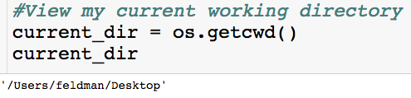
File Directories
Desktop
Input is file path as string
Directories separated by forward slash
Data_1
Data_2
Returns current working directory as string.

Slide 27
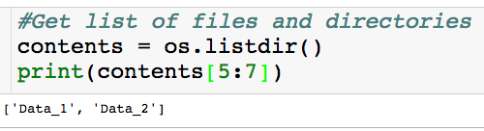
File Directories
Desktop
Input is file path as string
Directories separated by forward slash
Data_1
Data_2
Returns current working directory as string.
Returns list of strings

Slide 28
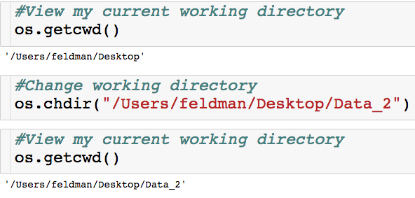
Navigating – Absolute Reference
Desktop
Data_1
Data_2

Slide 29
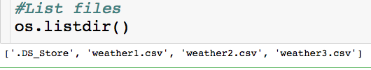
Navigating – Absolute Reference
Desktop
Data_1
Data_2

Slide 30
Navigating – Absolute Reference
Desktop
Data_1
Data_2

Slide 31
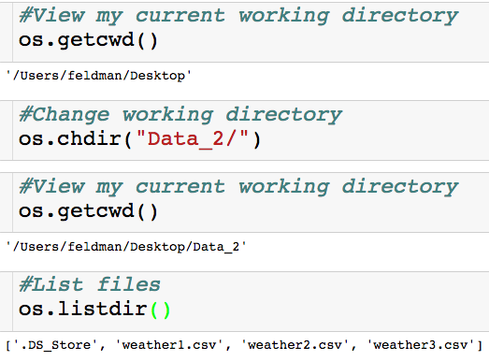
Navigating – Relative Reference
Desktop
Data_1
Data_2

Slide 32
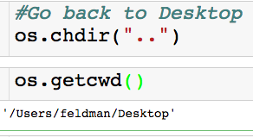
Navigating – Relative Reference
Desktop
Data_1
Data_2

Slide 33
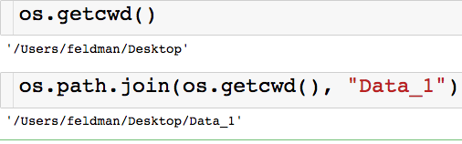
Navigating – Join Method
Desktop
Don’t have to worry about formatting
Returns a string that represents new directory
Data_1
Data_2

Slide 34
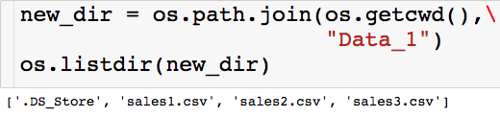
Navigating – Join Method
Desktop
Don’t have to worry about formatting
Returns a string that represents new directory
Data_1
Data_2
Can give listdir() a directory as a string as input.

Slide 35
Numpy + Scipy
These package are useful for simulation and efficient computation
Things we can do with numpy and scipy:
Generate random numbers
Matrix algebra – matrix inversion, eigenvalues, dot products, etc …
Solve linear program

Slide 36
Pandas
This will be our main package for data analytics
Things we can do with pandas:
Read/write csv and excel files
SQL
Data visualization
Regression

